Slide 1

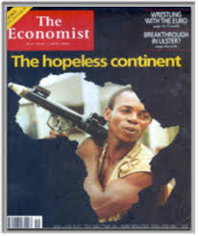

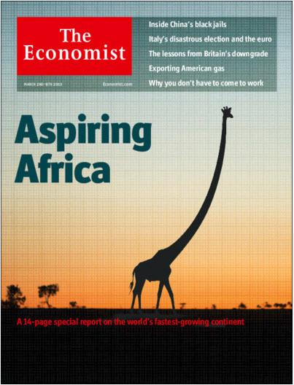
African Economic Growth: Yesterday, Today, Tomorrow
2000
2001
2011
2013

Slide 2
Outline
The African “growth miracle”
Growth and well-being
Sources of SSA growth
  Increases in factors of production
  Increases in productivity
Diversity of experience
The future of SSA growth

Slide 3
African “economic miracle” 1995-2016

Slide 4
SSA: GDP growth rates; real GDP per capita (1997-2016)
Source: World Bank, World Development Indicators

Slide 5
SSA Growth: five year intervals
Source: World Bank, World Development Indicators

Slide 6
Growth and well-being

Slide 7
SSA Poverty (at $1.90 per day)
Source: World Bank, Povcalnet

Slide 8
Growth is highly correlated with declines in poverty
Source: David Dollar and Aart Kraay, “Growth is Good for the Poor”

Slide 9
Average annual percentage change in health indicators (1960-2014)
Source: World Bank, World Development Indicators

Slide 10
Changes in use of modern floors, selected countries
Source: Macro International, Demographic and Health Surveys, Various dates

Slide 11
What else matters in reducing poverty?
There are growth patterns that are not poverty-reducing –especially those that depend on mineral resources
In any case, we know a lot more about how to increase growth than to decrease inequality
Income distributions tend to be stable over time
Investing in children has very important growth and equality impacts.
Perhaps the best approach to deal with people living in areas far from markets and with limited resources is to increase mobility
Some social protection programs can raise growth rates in sustainable ways; specific programs need to be carefully researched

Slide 12
Sources of growth in SSA
Growth in factors of production
  Capital stock
  Growth of labor supply and growth of human capital stock
Increases in productivity
  Changes due to structural change
  Changes dues to policy reforms
  Technological change
  Changes due to governance

Slide 13
SSA: Per capita growth decomposition, by five year periods (centered on year noted)
Per Capita Growth (%)
Source: Cho and Tien, “Sub-Saharan Africa’s recent growth spurt: An Analysis of the sources of growth”

Slide 14
Growth in factors of production

Slide 15
Gross domestic savings as % of GDP
EAP
MENA
South Asia
LAC
SSA
Source: World Bank, World Development Indicators

Slide 16
SSA: Savings as a % of GDP
Source: World Bank, World Development Indicators

Slide 17
SSA: Foreign inflows as percentage of GDP
ODA
FDI
Remittances
Source: World Bank, World Development Indicators

Slide 18
Investment as a % of GDP
EAP
MENA
SSA
LAC
Source: World Bank, World Development Indicators

Slide 19
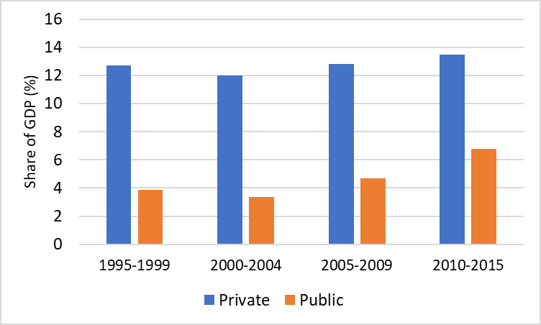
SSA: Private and public investment
Source: World Bank, World Development Indicators

Slide 20
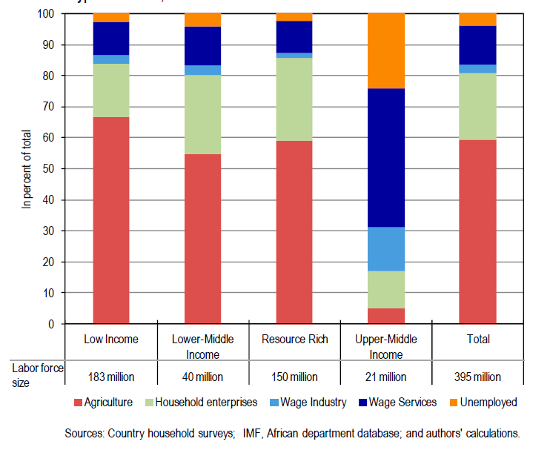
SSA: Breakdown of employment by country group and employment sector (2010)

Slide 21
SSA: Indicators of human capital (1975-2014)
Primary enrollment rates
Life expectancy
Secondary enrollment rates
2015
Source: World Bank, World Development Indicators

Slide 22
Increase in factors of production
Capital intensity (responsible for 0.9% growth in GDP per capita); investment and savings rates are lower than they should be
Human capital improvement (responsible for 0.5% growth in GDP per capita); access is increasing, but quality is a major problem
Demographic dividend (responsible for 0.4% growth in GDP per capita); increasing over time, but could accelerate even more with declining birth rates
Labor force increases (responsible for 0.1% growth in GDP per capita); not a dynamic contributor to growth

Slide 23
Increasing productivity (1) Structural Transformation

Slide 24
Structural transformation (the shift from agrarian economies to post-agrarian economies
Structural transformation is marked by
  Declining share of agricultural output in GDP
  Declining share of agricultural labor in total employment
  Increasing urbanization
  Declining fertility rates

Slide 25
Structural Transformation is happening in SSA, but later and more slowly than in other regions
Source: World Bank, World Development Indicators

Slide 26
Agriculture’s share of FTEs has declined in several SSA countries
Source: Yeboah and Jayne, “Africa’s evolving employment structure”

Slide 27
SSA: Labor productivity by sector (2005)
Source: McMillan and Harttgen, “What is driving the African “growth miracle?”

Slide 28
Productivity changes: within vs. structural
1990-1999
Post 2000
Source: ibid

Slide 29
Agriculture
Growth in agricultural productivity is critical to structural transformation

Slide 30
SSA: Measures of agricultural progress
Source: World Bank, World Development Indicators

Slide 31
Cereal yields by region (kg/ha)
East Asia Pacific
LAC
South Asia
MENA
SSA
Source: World Bank, World Development Indicators

Slide 32
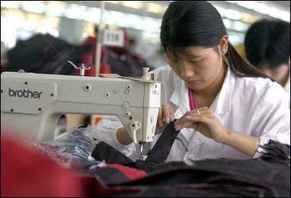
Is Africa’s structural transformation different?
The development paradigm that most economists think about is the experience of first East Asia and then Southeast and South Asia.
That model is based on the Arthur Lewis model of an agricultural surplus being a source of labor and capital for the non-agricultural economy, particularly manufacturing.

Slide 33
Manufacturing as share of GDP in SSA is the lowest among developing regions and is falling
Manufacturing as % of GDP is falling globally.
Share of SSA manufacturing in GDP is 50% lower than that of South Asia and has been falling up through 2007, when it steadied.
Source: World Bank, World Development Indicators

Slide 34
On the other hand, maybe manufacturing is just hitting its stride
Source: World Bank, World Development Indicators

Slide 35
New World Bank study Rethinking the Future of Manufacturing-Led Development says:
The Global economy is changing; manufacturing is not as dynamic as it once was; slowing global growth, automation, and changing global supply chains make the coming decades harder for developing countries than prior decades. Nevertheless policy changes can help
Competitiveness: including especially improvements in business environment, rule of law and improved technology in the financial sector.
Capabilities: Equip workers with new skills, build stronger firms, and develop the necessary infrastructure to adopt new technologies.
Connectedness: Improve logistics, lower trade restrictions on manufactured goods, and lower trade restrictions on services.

Slide 36
Other factors affecting total factor productivity
Macroeconomic policy
Governance
Technology
Conflict
Demographic dividend

Slide 37
SSA: Inflation: Annual increase in GDP Deflator (%)
Source: World Bank, World Development Indicators

Slide 38
SSA: External debt as % of GNI
Source: World Bank, World Development Indicators

Slide 39
Economic Governance: World Bank governance categories
Voice and Accountability (political governance)
Political Stability and Absence of Violence (political governance)
Government Effectiveness (economic governance)
Regulatory Quality (economic governance)
Rule of Law (economic governance)
Control of Corruption (economic governance))

Slide 40
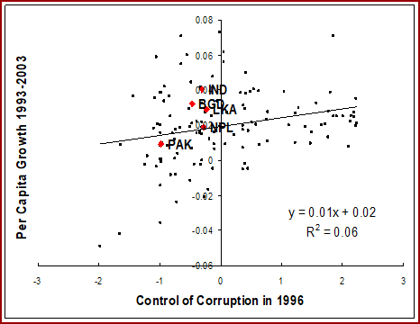
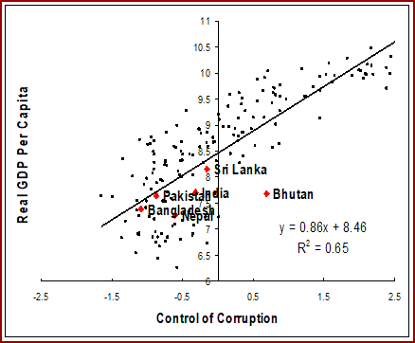
Corruption and other governance categories are not correlated with growth, but with long-run per capita income
Source: Aart Kraay

Slide 41
Technological change
The biggest bang for the buck with respect to technological change is increasing the adoption rate of better technologies, not the development of new technologies, e.g.,
  Mobile phones
  Bednets
  Hybrid seeds
  Piped water
  Radios
  Electricity connections

Slide 42
GDP per capita in four conflict-beset countries
DRC
Liberia
Source: World Bank, World Development Indicators

Slide 43
Demographic transition: Crude birth rates: 1960-2014
South Asia
MENA
East Asia
2015
Source: World Bank, World Development Indicators

Slide 44
Working age population as share of total population

Slide 45
Diversity of Economic Experience

Slide 46
Distribution of SSA Per Capita Growth Rates (1975-1995 vs. 1995-2016)
Source: World Bank, World Development Indicators

Slide 47
The Magnificent Seven (M7)
Burkina Faso
Ethiopia
Ghana
Mozambique
Rwanda
Tanzania
Uganda

Slide 48
Comparison of growth rates: M7 vs. other (1995-2015)
Source: World Bank, World Development Indicators

Slide 49
Characteristics of M7 countries: Ratio of M7 to Other SSA
Source: World Bank, World Development Indicators

Slide 50
Policy performance: SSA vs. Other SSA
(World Bank CPIA)
Source: World Bank, World Development Indicators

Slide 51
World Governance Indicators:
M7 vs Other SSA
Source: World Bank, World Development Indicators

Slide 52
What makes M7 countries special?
M7 countries largely, but not entirely, emerged from wars of national liberation.
They are, on average, sizeable countries, with populations averaging 40 million, and have large domestic markets.
They are low income countries, with per capita income levels one-third of the average SSA country.
Their most important quality is government effectiveness—fertilizer actually gets to farmers, roads are built and maintained, adult literacy programs work.

Slide 53
Ethiopia: changes in travel time to city of at least 50,000 people
World Bank, Ethiopia’s Great Run

Slide 54
Future of SSA Growth
Global slowdown
Policy regression
Climate change

Slide 55
IMF past and projected SSA GDP growth (%)

Slide 56
Headwinds (1): Annual global GDP growth(%), 1961-2015
Source: World Bank, World Development Indicators

Slide 57
Headwinds (2) Policy regression –SSA debt service
Source: World Bank, World Development Indicators

Slide 58
Headwinds (3): Climate change
The sub-continent will get hotter
Some areas will get drier, while others will get wetter
Sea levels will rise
Weather will become more extreme
Health outcomes will be threatened
Some observers assert that threats of conflict may rise
In total, while predictions of overall impact are subject to high levels of uncertainty, no one thinks the impacts will be beneficial

Slide 59
Conclusions
1995-2015 was a period of rapid economic growth for many countries in SSA; although growth began to decline by the end of the period
In the future it will be more difficult to sustain high levels of growth
Key policy issues:
  Maintain macroeconomic stability
  Improve microeconomic policy
  Emphasize reduction of fertility
  Government effectiveness is very important

